Slide 1
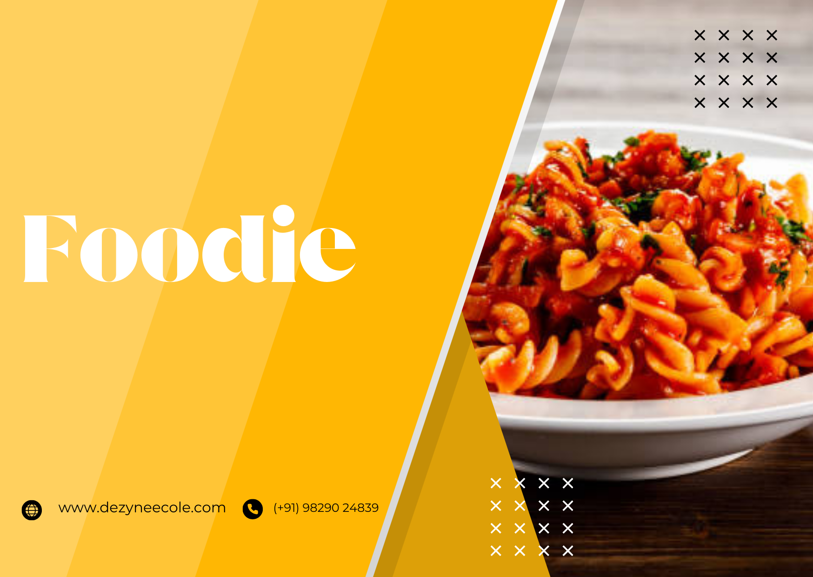

+
Foodies: Restaurant 24X7
Language Used:
HTML, CSS, Java Script, Bootstrap
Designed By:
Usha Assudani, Harshita Harwani, Minal Sharma

